Slide 1
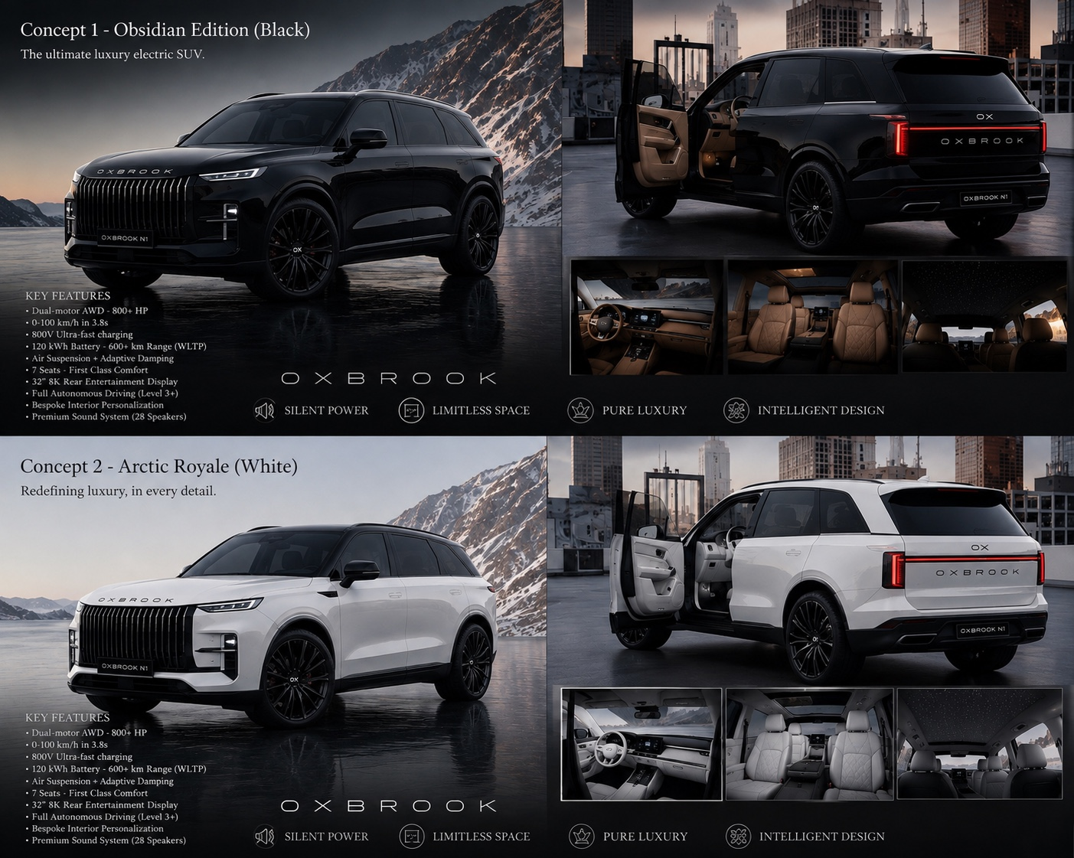
OXBROOK
N1
THE NEXT GENERATION OF
ULTRA-LUXURY ELECTRIC SUVs
Investor Presentation • V0.1 • August 2026

Slide 2
01 / OPPORTUNITY
The full-size luxury EV is becoming a category.
The market is proving that buyers will pay six figures for a large, highly equipped electric SUV.
CADILLAC ESCALADE IQ
LUCID GRAVITY
THE GAP
2026 starting price: $127,405
7 seats • AWD • 24" available
Cadillac-est. up to 465 miles
2026 starting price: $79,900
Up to 7 adults • AWD
Up to 450-mile EPA-est. range
A new entrant can compete on:
• design identity
• bespoke luxury
• rarity
• family-first packaging
Source: Cadillac official 2026 Escalade IQ page; Lucid official Gravity pages. Pricing/range are market references, not OXBROOK forecasts.
OXBROOK N1 / INVESTOR DECK / V0.1
2

Slide 3
02 / PRODUCT
Meet the OXBROOK N1.
A full-size, seven-seat luxury EV designed to feel like a flagship—not an electric crossover.
7 SEATS
AWD
Family-first flagship
Dual electric motors
800V
~140 kWh
High-voltage architecture
Battery target
24"
750–850 hp
Signature wheel size
System target
Design reference shown is the current N1 concept board. Technical targets remain subject to engineering validation.
OXBROOK N1 / INVESTOR DECK / V0.1
3

Slide 4
03 / DESIGN
The design is the moat.
OXBROOK is not trying to look like another anonymous EV.
OBSIDIAN BLACK
A commanding,
architectural presence.
• Tall signature grille
• Thin lighting signature
• Long, clean shoulder
• 24-inch wheel stance
• Distinctive OX rear identity
• Quiet, premium interior
OXBROOK N1 / INVESTOR DECK / V0.1
4

Slide 5
04 / CUSTOMER
The OXBROOK buyer wants the biggest thing—but not the most obvious thing.
• High-income families and entrepreneurs buying a flagship SUV.
• Wants seven genuine seats, exceptional comfort and a commanding presence.
• Values design, rarity and personalization as much as raw performance.
• Open to EVs but does not want a compromise in size, luxury or practicality.
• Willing to pay for a vehicle that feels exclusive rather than mass-market.
PRIMARY PURCHASE TRIGGER
“I want a luxury SUV that nobody else in my street has.”
SECONDARY TRIGGER
Family space + silent EV comfort + effortless performance.
TRUST REQUIREMENT
Automotive-grade reliability, service and warranty.
OXBROOK N1 / INVESTOR DECK / V0.1
5

Slide 6
05 / POSITIONING
A new luxury marque, not another EV startup.
OXBROOK
Range Rover
Escalade IQ
Lucid Gravity
Luxury identity
★★★★★
★★★★★
★★★★☆
★★★★☆
RARE + COMMANDING + BESPOKE
7-seat focus
★★★★★
★★★★★
★★★★★
★★★★★
Design distinctiveness
★★★★☆
★★★★★
★★★★☆
★★★★★
Bespoke potential
★★★★★
★★★★☆
★★★☆☆
★★★★★
New-brand rarity
★★☆☆☆
★★☆☆☆
★★★☆☆
★★★★★
Competitive framing is directional and qualitative; it is not a claim that OXBROOK currently matches the established brands' capabilities.
OXBROOK N1 / INVESTOR DECK / V0.1
6

Slide 7
06 / ARCHITECTURE
A premium vehicle built from proven automotive building blocks.
BATTERY
POWERTRAIN
CHASSIS
~140 kWh gross • 800V
Target 125–135 kWh usable
Dual eAxle AWD
~750–850 hp system target
Air suspension • adaptive damping
24" wheels • RWS provision
CABIN
CHARGING
E/E + ADAS
7 seats standard
6-seat Executive option
800V • 250–350 kW target
Fast-charge architecture
Central VCU • Ethernet/CAN
Advanced Level 2 target
The strategy is to own vehicle integration and customer experience while sourcing mature subsystems from Tier-1 automotive suppliers.
OXBROOK N1 / INVESTOR DECK / V0.1
7

Slide 8
07 / MANUFACTURING
Don't build a factory before we have a product.
• OXBROOK owns product definition, design, brand, software experience and vehicle integration.
• Tier-1 suppliers provide proven powertrain, battery, chassis, electrical and ADAS systems.
• A complete-vehicle engineering partner develops the prototype and production architecture.
• P001 proves the vehicle. P002/P003 prove durability and homologation readiness.
• Low-volume contract manufacturing comes before any OXBROOK-owned factory.
STRATEGIC PARTNER
Magna is a key candidate because it publicly offers complete-vehicle engineering, prototyping and low-volume manufacturing.
SUPPLIER MODEL
Battery • eAxles • power electronics • chassis • brakes • ADAS • seating
CAPITAL DISCIPLINE
Spend capital on proving the car—not on idle factory capacity.
OXBROOK N1 / INVESTOR DECK / V0.1
8

Slide 9
08 / SUPPLIER ARCHITECTURE
Candidate Tier-1 ecosystem
Battery
CATL / equivalent
~140 kWh, 800V-class
eAxles
BorgWarner / Valeo / Bosch
Dual integrated eAxle
Power electronics
Valeo / equivalent
OBC + DC/DC + PDU
Chassis
ZF / Nexteer / Brembo
Air suspension + steering + brakes
ADAS
Mobileye / equivalent
Advanced Level 2 target
HV interconnect
Aptiv / Phoenix Contact
HV wiring + charging inlet
Seats
Lear / equivalent
Luxury 7-seat / Executive 6-seat
All names above are candidate suppliers for RFQ/feasibility discussions. No partnership is implied.
OXBROOK N1 / INVESTOR DECK / V0.1
9

Slide 10
09 / TRACTION
P001 is the next proof point.
CONCEPT
→
P001
→
P002 / P003
→
→
HOMOLOGATION
SERIES
• P001: functional engineering vehicle, not a show car.
• Proves battery packaging, AWD, thermal management, suspension, steering and braking.
• Creates real supplier interfaces and vehicle-level data.
• P001 planning envelope: approximately €2.5M–€7.0M.
• Next financing milestone: fund P001 and convert design credibility into engineering credibility.
WHAT INVESTORS BUY
Evidence that the N1 can move from render → running vehicle.
WHAT P001 UNLOCKS
Supplier contracts • engineering data • prototype footage • customer confidence
OXBROOK N1 / INVESTOR DECK / V0.1
10

Slide 11
10 / BUSINESS MODEL
A high-margin flagship can be the first product, not the whole company.
N1 VEHICLE
BESPOKE
SERVICES
FUTURE MODELS
Core revenue
Premium flagship SUV
Interior materials
Paint • trim • personalization
Connected services
Software / OTA
N1 variants
Future OXBROOK vehicles
Illustrative pricing architecture
N1 Luxury
€95–115k target
Pricing is preliminary positioning—not a forecast or final MSRP.
N1 Signature
€115–135k target
N1 Executive
€130k+ target
OXBROOK N1 / INVESTOR DECK / V0.1
11

Slide 12
11 / ECONOMICS
The first round should buy measurable milestones.
Illustrative planning case — not a forecast
Year
Milestone
Vehicles
Objective
2027
P001
0–5
Development / prototype
2028
Validation
5–25
P002/P003
2029
Launch
100
Low-volume production
2030
Scale
500
Supplier + manufacturing ramp
2031
Scale
1,500
Established low-volume program
ROUND 1
ROUND 2
SERIES
Fund engineering + P001
Fund validation + homologation
Fund production ramp
OXBROOK N1 / INVESTOR DECK / V0.1
12

Slide 13
12 / THE ASK
Raise the first round to turn design into proof.
TARGET ROUND
• Recruit automotive CTO / vehicle engineering leadership.
• Complete package and supplier feasibility.
• Secure battery/eAxle/chassis engineering pathways.
• Develop and build P001.
• Generate real vehicle-level data and prototype footage.
• Validate customer demand and begin reservation/LOI program.
• Prepare P002 and institutional Series A financing.
€5M
illustrative pre-seed target
The exact round size should be finalized after supplier feasibility and a complete-vehicle engineering quote.
OXBROOK N1 / INVESTOR DECK / V0.1
13

Slide 14
13 / WHY OXBROOK
The category is moving toward exactly the product we want to build.
• Full-size luxury EVs are now being sold above $125k by established manufacturers.
• Seven-seat EV SUVs are becoming credible family flagships.
• 24-inch wheels, executive rear seating, air suspension and four-wheel steering are already being accepted in the category.
• New entrants can use established Tier-1 suppliers and contract manufacturing instead of vertically integrating every subsystem.
• OXBROOK can enter with a highly differentiated design rather than competing on commodity EV specifications.
MARKET PROOF
Cadillac Escalade IQ: $127,405 starting price; 7 seats; 24" available.
EV PROOF
Lucid Gravity: up to 7 adults and up to 450-mile EPA-est. range.
DESIGN OPENING
OXBROOK's differentiation is the visual product itself.
OXBROOK N1 / INVESTOR DECK / V0.1
14

Slide 15
14 / ROADMAP
From beautiful idea to road-legal luxury brand.
2026
Foundation
Brand • design freeze • market research • technical RFQs
2027
P001
Engineering partner • running prototype • first vehicle data
2028
Validation
P002/P003 • durability • thermal • software • homologation
2029
Launch
Low-volume customer production
2030+
Scale
N1 variants • additional markets • next OXBROOK platform
OXBROOK N1 / INVESTOR DECK / V0.1
15

Slide 16
15 / TEAM
The product is strong. The next hire is critical.
OXBROOK TODAY
NEXT KEY ADDITIONS
Product vision • brand • design direction • program ownership
CTO / Vehicle Engineering Lead
Automotive development + systems integration
Manufacturing Advisor
Vehicle industrialization + supplier management
Battery / EV Advisor
Cell, pack, thermal and charging expertise
Homologation Advisor
EU + U.S. regulatory strategy
Investor message: OXBROOK is intentionally building a senior automotive execution layer around the product vision.
OXBROOK N1 / INVESTOR DECK / V0.1
16

Slide 17
16 / MILESTONES
What the first capital must accomplish.
0–3 months
Company + IP
Legal entity, trademark strategy, advisor/CTO search
3–6 months
Engineering freeze
Package, supplier RFQs, Magna feasibility
6–12 months
P001
Running engineering prototype
12–18 months
Validation
Thermal, handling, charging, durability
18–30 months
P002/P003
Production-intent architecture
OXBROOK N1 / INVESTOR DECK / V0.1
17

Slide 18
OXBROOK
N1
CRAFTED WITHOUT COMPROMISE.
OXBROOK N1 / INVESTOR DECK / V0.1
18

